Slide 1
Mining Function Call Sequence Patterns Across Different Versions of the Project for Defect Detection
Zhanqi Cui¹, Xiang Chen², Yongmin Mu¹, Zhihua Zhang¹, and Xu Ma¹
¹Computer School, Beijing Information Science and Technology University, Beijing, China
²School of Computer Science and Technology, Nantong University,
Nantong, China

Slide 2
Outline
1. Introduction
2. Our Approach
3. Experiments and Evaluation
4. Conclusions

Slide 3
1. Introduction
A large number of programming rules are implied in programs
Violate these rules may introduce software defects
Saied et al. found 3 out of 4 constraint types, from 79% to 88% usage constraints are nondocumented
Saied, M.A. et al. An observational study on API usage constraints and their documentation. SANER 2015.

Slide 4
Mining Programming Rules
Recently, a large body of techniques for mining programming rules are conducted.
The programming rules and suspicious defects reported are huge.
PR-Miner: 32283 candidate program rules, and reported 1447 suspicious defects after inter-procedural analysis.
Legunsen et al.: 98% of 200 suspicious defects which violate automatically mined specifications are false positives.
Legunsen, O., et al. How good are the specs? A study of the bug-finding effectiveness of existing java API specifications. ASE 2016

Slide 5
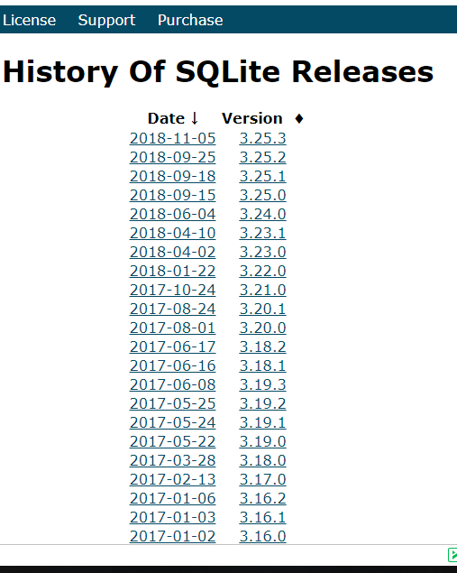
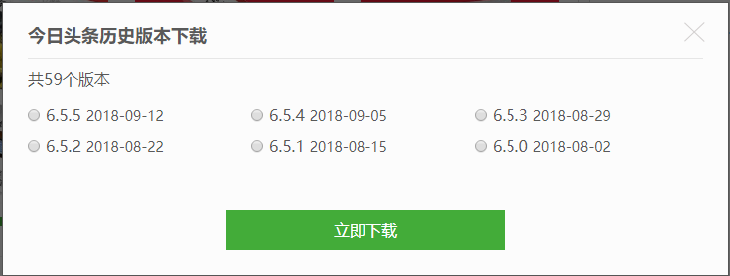

Historical Versions of Software
With the widespread of modern software engineering methods, such as
Agile methods
Iterative development
Mobile Internet
Produces a large number of historical versions.
the Today’s Headline, 4 versions each month/ 129 versions/2012.8-2016.8.
SQLite 294 releases over 18.2 years.

Slide 6
Idea
Historical version have been thoroughly tested and used for a period of time.
Similarity between different versions.
Use historical version information to help automatically filters programing patterns in current version under analysis (To be released).

Slide 7
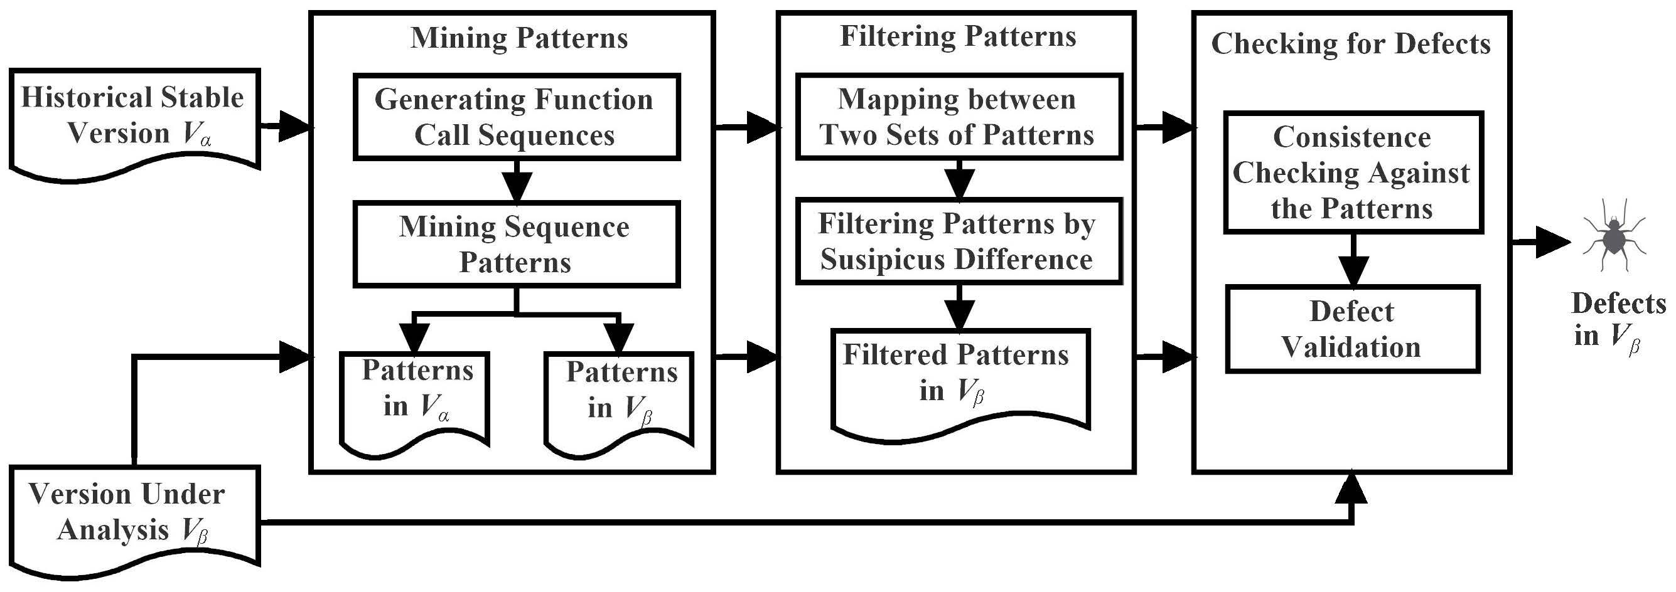
2. Our Approach
Focus on function call sequence patterns

Slide 8
2.1 Mining Function Call Sequence Patterns
A version of a program which is composed by functions can be expressed as a set
A function, which is composed by statements, can be expressed as
Statements in the program can be categorized as variable define/use, conditional branch, function call etc.

Slide 9
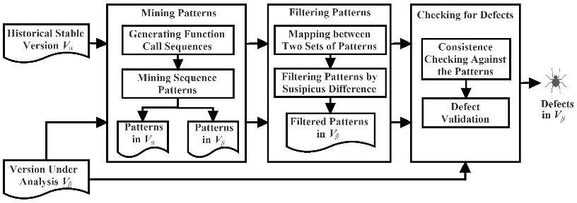
2.1 Mining Sequence Patterns
Item Function call statement
Sequence A sequence of items in a function
Suppose a sequence , the support count of is the number of sequences in which contain . Support is the rate of sequences, which contain in the program
GSP algorithm mining frequent sequence

Slide 10
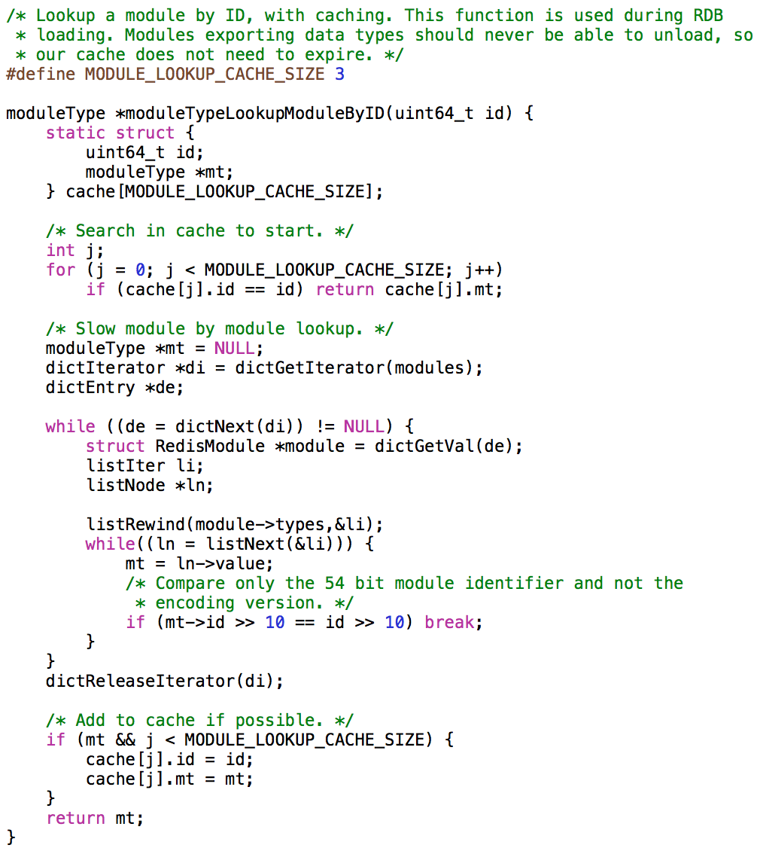
Items Function call statements
Sequence A sequence of items
<dictGetIterator(),dictNext(),listRewind(),listNext(),dictReleaseIterator()>
@moduleTypeLookupModuleByID
@module.c
@line: 2530

Slide 11
Some function call sequences in Redis project
……
dictGetIterator(),dictNext(),listRewind(),listNext(),memcmp(),dictReleaseIterator(),dictReleaseIterator()@moduleTypeLookupModuleByName@module.c@line: 2503
……
dictGetIterator(),dictNext(),listRewind(),listNext(),dictReleaseIterator()@moduleTypeLookupModuleByID@module.c@line: 2530
……
dictGetIterator(),dictNext(),ziplistIndex(),ziplistNext()@zuiInitIterator@t_zset.c@line: 1819
……
dictGetIterator(),dictNext(),dictFind(),serverLog(),sdsfree(),sdsempty(),listDelNode(),dictReleaseIterator()@rewriteConfigRemoveOrphaned-@config.c@line: 1771
……
Frequenet Sequence Pattern（minSupCount＝15）
<dictGetIterator(), dictNext(), dictReleaseIterator()> （supCount = 36）

Slide 12
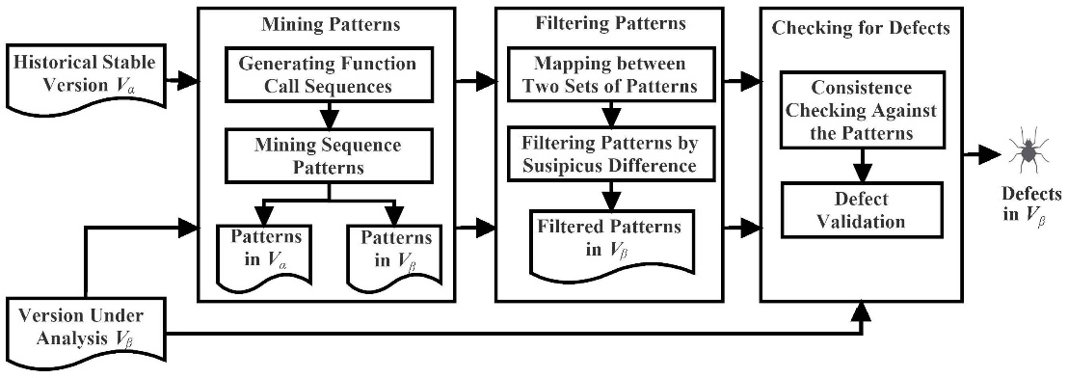
2.2 Filtering Sequence Patterns
After mining sequence patterns from a stable version and a new version ，filter candidate patterns by
The confidence of a candidate pattern
The confidence change of a candidate pattern in the two versions

Slide 13
Confidence of patterns
The proportion of function call sequences which contain the pattern out of the sum of function call sequences either contain or violate the pattern in the program.
set as a threshold value for confidence

Slide 14
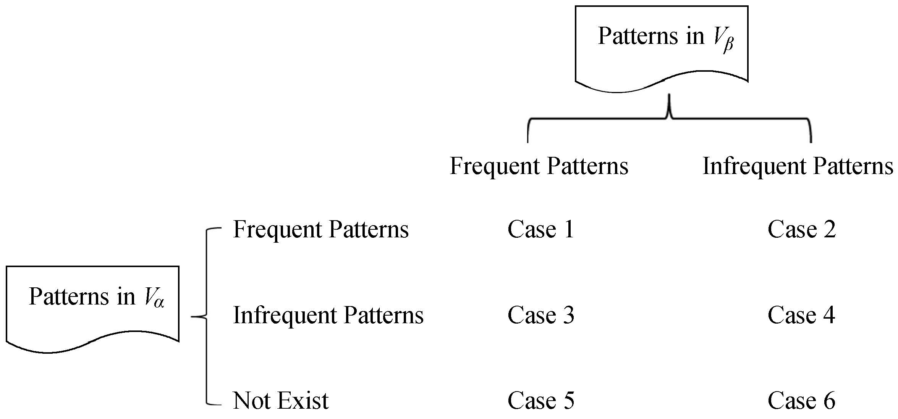
6 cases of patterns between two 2 versions
Many implied programming rules can be found as frequent patterns in both version and
While other patterns are only frequent or even only exist in one version.

Slide 15

Patterns in 3.2.12 and 4.0.10 of Redis
Case1
<'dictNext()', 'dictReleaseIterator()’ > <'dictGetIterator()', 'dictNext()’ > <'dictGetIterator()', 'dictReleaseIterator()’ > <'getDecodedObject()', 'decrRefCount()’ > <'getLongFromObjectOrReply()', 'addReply()’ > <'lookupKeyReadOrReply()', 'checkType()’ > <'dictGetIterator()', 'dictNext()', 'dictReleaseIterator()’>
Case2
<'dbAdd()', 'signalModifiedKey()’> <'dbDelete()', 'notifyKeyspaceEvent()’>

Slide 16
Heuristics to Filter Candidate Patterns
has been thoroughly tested and used by users for a period of time, we gain more confidence on than .
confidence decreases, new places violating the rule are found in , new defects probably introduced.
confidence remains the same or increase, no new defects related to this rule are introduced.
confidence increases or decreases too much, it may be a false pattern. Patterns with greater than are considered to be false positives.
Notes:
We assume that the programmer writes correct code in most of the time and only makes mistakes occasionally.

Slide 17
2.2 Filtering Sequence Patterns
For a stable version and a new version , the confidence change of a sequence pattern s is defined as
Case1 | Conf in V_{α} | Conf in V_{β} | δ_{conf}
<'dictNext()', 'dictReleaseIterator()’ > <'dictGetIterator()', 'dictNext()’ > <'dictGetIterator()', 'dictReleaseIterator()’ > <'getDecodedObject()', 'decrRefCount()’ > <'getLongFromObjectOrReply()', 'addReply()’ > <'lookupKeyReadOrReply()', 'checkType()’ > <'dictGetIterator()', 'dictNext()', 'dictReleaseIterator()’> | 91.89% 89.19% 91.11% 95.45% 88.00% 96.97% 97.06% | 92.86% 90.48% 92.45% 94.44% 88.46% 96.77% 97.44% | =0 =0 =0 <0 =0 <0 =0

Slide 18
2.3 Checking for Defects
The function call sequence of a function definition violates a function call sequence pattern
includes a subsequence of
but a function call statement is not included in

Slide 19
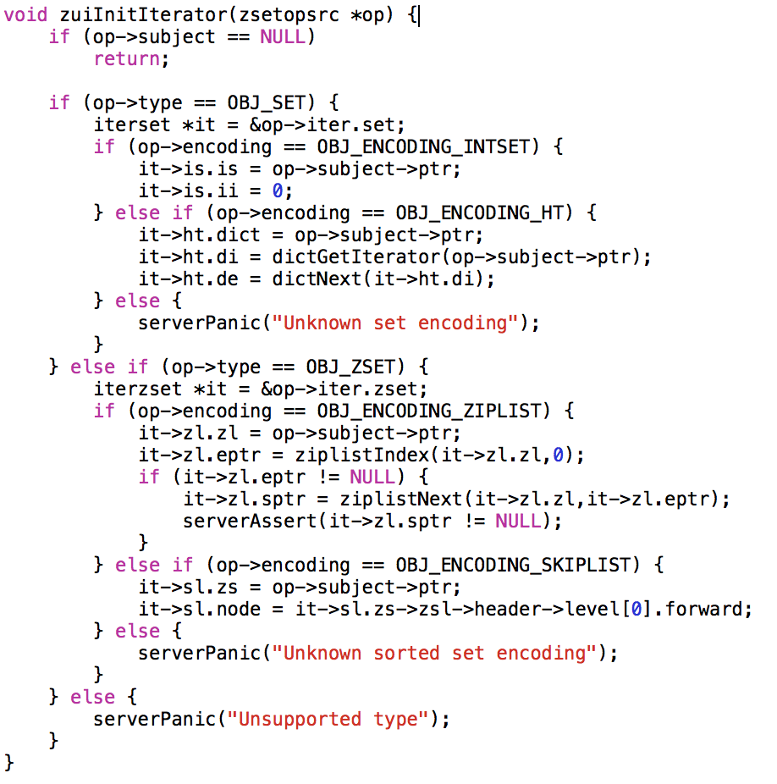
s=<dictGetIterator(), dictNext(), dictReleaseIterator()>
s'=<dictGetIterator(), dictNext() >
dictGetIterator(), dictNext(), ziplistIndex(), ziplistNext()
@zuiInitIterator
@t_zset.c
@line: 1819
Include s’, but not s
Violate found
Suspicious defect
Notes:
Redis

Slide 20
Suspicious
To measure certainty of a reported defects quantitatively
Only violations with suspicious no less than minSus are reported as suspicious defects
Since we assume programmers only make mistakes occasionally.
Case1 | δ_{conf} | Suspicious
<'getDecodedObject()', 'decrRefCount()’ > <'lookupKeyReadOrReply()', 'checkType()’ > | -0.0101 -0.0020 | 98.99% 99.80%

Slide 21
3. Experiments and Evaluation
Platform
Intel i7 2.3 GHz CPU, 8GB Memory
Ubuntu16.04, Python 3.4
CV-Miner
Program analysis module, generates function call sequences in both two versions
Rapidminer, mine function call sequence patterns, respectively
Defect detection module, filters out the candidate patterns and find suspicious violates
RapidMiner, https://rapidminer.com.

Slide 22
Experimental Subjects
Projects | Versions | .c files | LOC | Function Definitions (Sequences) | Function Calls
Redis | 4.0.10 | 75 | 47887 | 1854 | 11629
 | 3.2.12 | 61 | 40223 | 1488 | 9641
Lua | 5.4.0 | 34 | 16340 | 984 | 2984
 | 5.3.5 | 35 | 14610 | 900 | 2756
Sqlite | 3.24.0 | 2 | 142713 | 2251 | 13265
 | 3.23.1 | 2 | 141320 | 2224 | 13090
Redis: major.minor.patchlevel
Lua:x.y.z, x.y is the version and z is the release.

Slide 23
Expriment Design
Research Questions
RQ1. Is it common that many programming rules across different versions of a project are the same?
RQ2. Can historical versions improve the efficiency of detecting defects by filtering programming rules?
RQ3. Can this approach comprise the capability of defects detection?
Compare CV-Miner with our previous work on mining sequence patterns for detecting defects (Seq-Miner)
Cui, Z. et al. Defects detection based on mining function call sequence patterns. SATE 2016

Slide 24
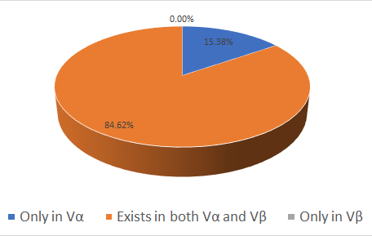
Rule Candidates across Different Versions
Projects | Only in V_{α} | Confidence in V_{β} − Confidence in V_{α} (exist in both V_{α} and V_{β}) |  |  | Only in V_{β} | Total in V_{α} | Total in V_{β}
 |  | δ_{conf}<0 | δ_{conf} =0 | δ_{conf} > 0
Redis | 2 | 2 | 0 | 5 | 0 | 9 | 7
Lua | 0 | 0 | 1 | 0 | 0 | 1 | 1
Sqlite | 0 | 0 | 3 | 0 | 0 | 3 | 3
SUM | 2 | 2 | 4 | 5 | 0 | 13 | 11
Answer for RQ1: same function call sequence patterns are contained in different versions of a project

Slide 25
Comparison of Execution Times
Projects | Method | Time to Generate Sequence Patterns | Time to Check for Suspicious Defects | Total Times
Redis | Seq-Miner | 26781 | 52 | 26834
 | CV-Miner | 46828 | 44 | 46872
Lua | Seq-Miner | 7683 | 29 | 7712
 | CV-Miner | 15441 | 28 | 15470
Sqlite | Seq-Miner | 15264 | 50 | 15314
 | CV-Miner | 30227 | 43 | 30270

Slide 26
Bug Injection
Two mutation operators for function call sequence patterns
Remove a function call statement
Change the order of two function call statements

Slide 27
Comparison of Defects Detection
Projects | Method | Candidate Patterns | Suspicious defects reported | Bugs
Redis | Seq-Miner | 7 | 19 | 2
 | CV-Miner | 1 | 6 | 2
Lua | Seq-Miner | 1 | 3 | 2
 | CV-Miner | 1 | 3 | 2
Sqlite | Seq-Miner | 3 | 16 | 2
 | CV-Miner | 1 | 8 | 2
SUM | Seq-Miner | 11 | 38 | 6
 | CV-Miner | 3 | 17 | 6
Answer for RQ2: the historical version can reducing candidate patterns and the suspicious defects, which need to be manually validated, to improve the efficiency of defects detection.

Slide 28
Comparison of Defects Detection
Projects | Method | Patterns | Suspicious defects reported | Bugs
Redis | Seq-Miner | 7 | 19 | 2
 | CV-Miner | 1 | 6 | 2
Lua | Seq-Miner | 1 | 3 | 2
 | CV-Miner | 1 | 3 | 2
Sqlite | Seq-Miner | 3 | 16 | 2
 | CV-Miner | 1 | 8 | 2
SUM | Seq-Miner | 11 | 38 | 6
 | CV-Miner | 3 | 17 | 6
Answer for RQ3: the CV-Miner method does not obviously comprise the capability of detecting defects, which violate function call sequence patterns

Slide 29
Conclusions
Improve the efficiency of mining programming rules for detect detection by exploiting the information of historical versions.
Results
The programming rules between different versions are similar
This approach can improve the efficiency of detecting defects by reducing candidate patterns and suspicious defects
The costs for manual validating are reduced

Slide 30
Future Work
Introduce incremental mining techniques to use all the versions of a project in the software repository.
Explore the possibility of apply this approach to other kinds of programming rules.
Empirical study to find new defects.

Slide 31
Thanks！Q&A
Zhanqi Cui¹, Xiang Chen², Yongmin Mu¹, Zhihua Zhang¹, and Xu Ma¹
¹Computer School, Beijing Information Science and Technology University, Beijing, China
²School of Computer Science and Technology, Nantong University,
Nantong, China

